Slide 1

Name - Ishwa Branch – CSE Semester – 5th sem Subject – Project - III Submitted to – MS. ANNU Mam

Slide 2
INGFCET MANAGEMENT SYSTEM IN JAVA

Slide 3
INDEX
REQUIREMENT SPECIFICATIONS
INTRODUCTION
OBJECTIVE
PURPOSE
SCOPE
ABOUT JAVA
ABOUT SQL
ADVANTAGE
CONTENT IN CMS
CONCLUSION
OUTPUT
IMPLEMENTATION
REFERENCES

Slide 4
REQUIREMENT SPECIFICATIONS
Hardware Requirement:
Processor Brand : Intel
Processor Type : Core i5
Processor Speed : 2.40GHz
Ram Size : 8.00 GB

Slide 5
Software Requirement
Operating system : Windows 10
Application Server : Java (NetBeans)
Front end : JAVA
Connectivity : JDBC Driver
Database connectivity : XAMPP (MYSQL Console)

Slide 6
Introduction
Overview:
INGFCET MANAGEMENT SYSTEM (INGFCETMS) is a flagship product of Easy Solution which covers all aspects of Universities and colleges. INGFCETMS covers every minute aspects of a universities workflow and integrates all processes with user friendly interface. INGFCETMS is first choice of several state, governments/semi- government universities and institutions. INGFCETMS streamline path of information flow in organization by taking care of following departments:
Fee Department
Examination Department
Attendance
Faculty information portal
Student information portal

Slide 7
Objective
The main objective of the INGFCET Management System is to manage the details of profiles, Logins, Exams, Fees, etc. It manages all the information about Profiles, Students, Fees, Profiles. The project is totally built at administrative end and thus only the administrator is guaranteed the access. The purpose of the project is to build an application program to reduce the manual work for managing the Profiles, Attendance, Attendance details, Exams, Fee details, Logins, etc. It tracks all the details about the logins, Exam, Fees.

Slide 8
Purpose
Drive operational efficiency.
Self-service systems with simple to use with little or no training.
Elimination of duplicate data entry processes.
Digitalize your data collection and management
Automation of all the Academic / Examination / Administration operations.
Ease and accuracy of reporting.

Slide 9
Scope
This project deals with the various functioning in College management process. The main idea is to implement a proper process to system. In our existing system contains a many operations registration, student search, fees, attendance, exam records, performance of the student etc. All these activity takeout manually by administrator.

Slide 10
ABOUT JAVA
Java is a general-purpose, class-based, object-oriented programming language designed for having lesser implementation dependencies. It is a computing platform for application development. Java is fast, secure, and reliable, therefore. It is widely used for developing Java applications in laptops, data centers, game consoles, scientific supercomputers, cell phones, etc.
Here are some important Java applications:
It is used for developing Android Apps
Helps you to create Enterprise Software
Wide range of Mobile java Applications
Scientific Computing Applications
Use for Big Data Analytics
Java Programming of Hardware devices
Used for Server-Side Technologies like Apache, JBoss, etc.

Slide 11
ABOUT SQL
SQL is Structured Query Language, which is a computer language for storing, manipulating and retrieving data stored in a relational database.
SQL is the standard language for Relational Database System. All the Relational Database Management Systems (RDMS) like MySQL, MS Access, Oracle, Sybase, Informix, Postgres and SQL Server use SQL as their standard database language.
MySQL is a fast, easy-to-use RDBMS being used for many small and big businesses. MySQL is developed, marketed and supported by MySQL AB, which is a Swedish company. MySQL is becoming so popular because of many good reasons.[1]
MySQL is released under an open-source license. So you have nothing to pay to use it. MySQL is a very powerful program in its own right. It handles a large subset of the functionality of the most expensive and powerful database packages. MySQL uses a standard form of the well-known SQL data language. MySQL works on many operating systems and with many languages including PHP, PERL, C, C++, JAVA, etc.
MySQL works very quickly and works well even with large data sets.

Slide 12
Also, they are using different dialects, such as −
Oracle using PL/SQL,.
SQL is widely popular because it offers the following advantages −
Allows users to access data in the database management systems.
Allows users to describe the data relational.
Allows users to define the data in a database and manipulate that data.
Allows to embed within other languages using SQL modules, libraries & pre-compilers.
Allows users to create and drop databases and tables.
Allows users to create view, stored procedure, functions in a database.
Allows users to set permissions on tables, procedures and views.

Slide 13
ADVANTAGE
Preserves time of teachers and administrators - It preserves the valuable time of teachers from daily admin works.
Reduction of Human Labor and Workload – The cost incurred from employing staff to manage students and college activities is an additional cost. With a management system, staff workload is reduced, and teachers can then engage the INGFCETMS more. This leads them to a reduction in teacher workload and saves them time that could be better spent in the classroom.
Complete Control - With INGFCETMS, every section of the institute is managed from a single platform. A quality INGFCETMS offers full control to monitor, manage, and access all the activities comprising of Profiles, Attendance, Attendance details, Exams, Fee details, Logins, etc. from a single platform.

Slide 14
CONTENT IN UMS
Login form: This page represents the first thing about our website. It leads on to the login point for its personnel; it takes up the username, password and signup.
Signup page: This page represents signing up to website. It leads to registering to website making username and password, it takes the up username, name, password and security question. These information are mandatory.
Home page user : This page shows us what user can see and access. He can add, remove, update and upload the data. He can logout from the website in homepage.
Student form : In this we can add the new student details which will be stored in back end of user. This details further can updated in the update page.

Slide 15
Teacher form: In this we can add the new teacher details which will be stored in back end of user. This details further can updated in the update page.
Marks and Subject page : In this page we can enter the subjects and marks scored in that particular subject along the roll no.
Fee payment page : In this page we can the pay the fee dues of the particular student which uses roll no, course, branch and Sem to pay the fee.

Slide 16
CONCLUSION
The project entitled as INGFCET Management System is the system that deals with the issues related to a particular institution.
This project is implemented with all the features mentioned in project.
The application provides appropriate information to users according to the chosen service. The project is designed keeping in view the day-to-day problems faced by a college.
Deployment of our application will certainly help the college to reduce unnecessary wastage of time in manual work for managing the Profiles, Attendance, Attendance details, Exams, Fee details, Logins, etc.
Awareness and right information about any college is essential for both the development of student as well as faculty. So, this serves the right purpose in achieving the desired requirements of both the communities.

Slide 17
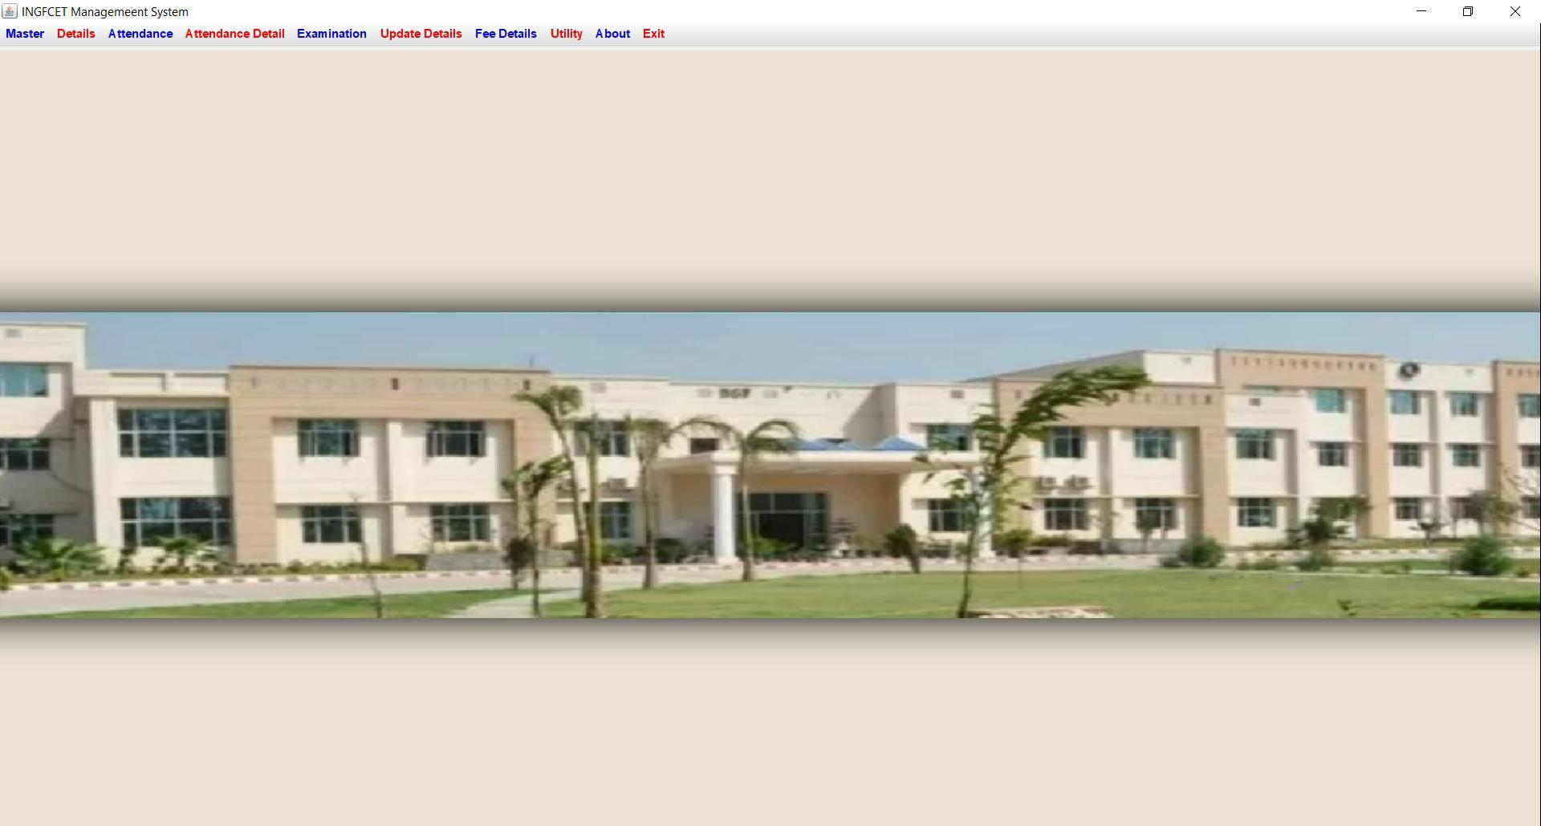
OUTPUT

Slide 18
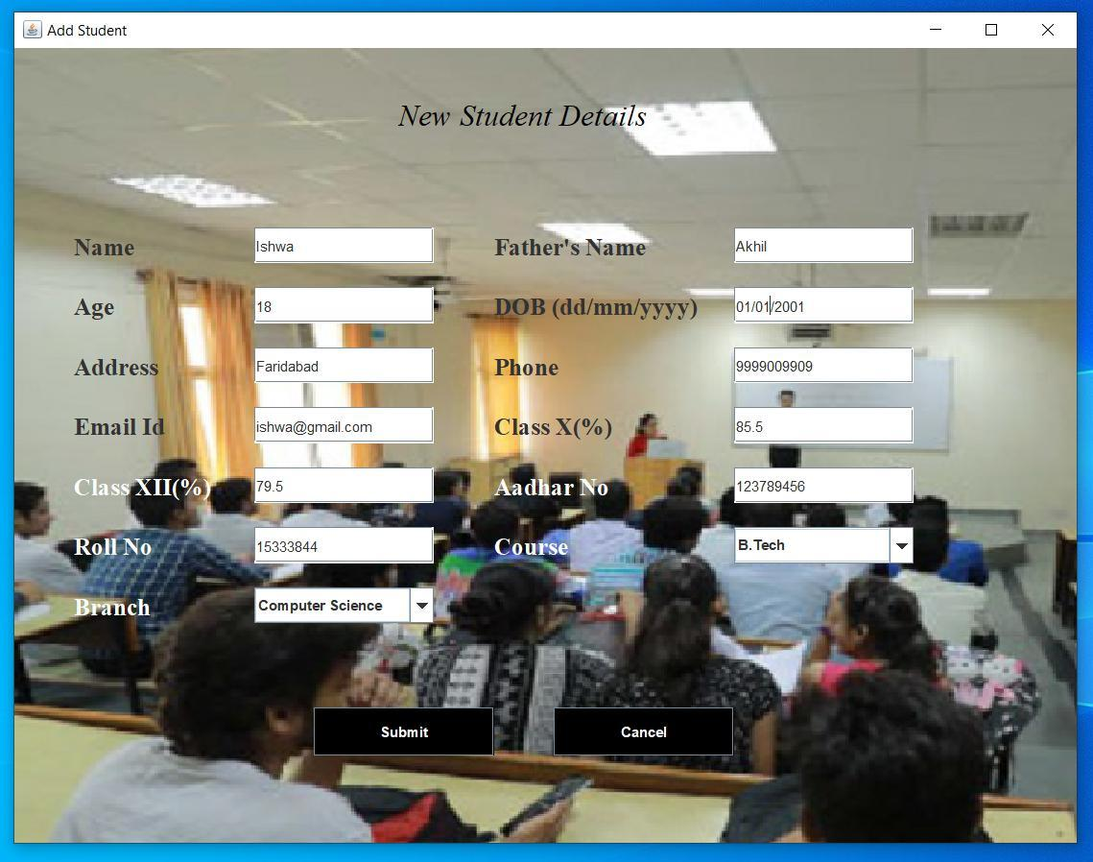
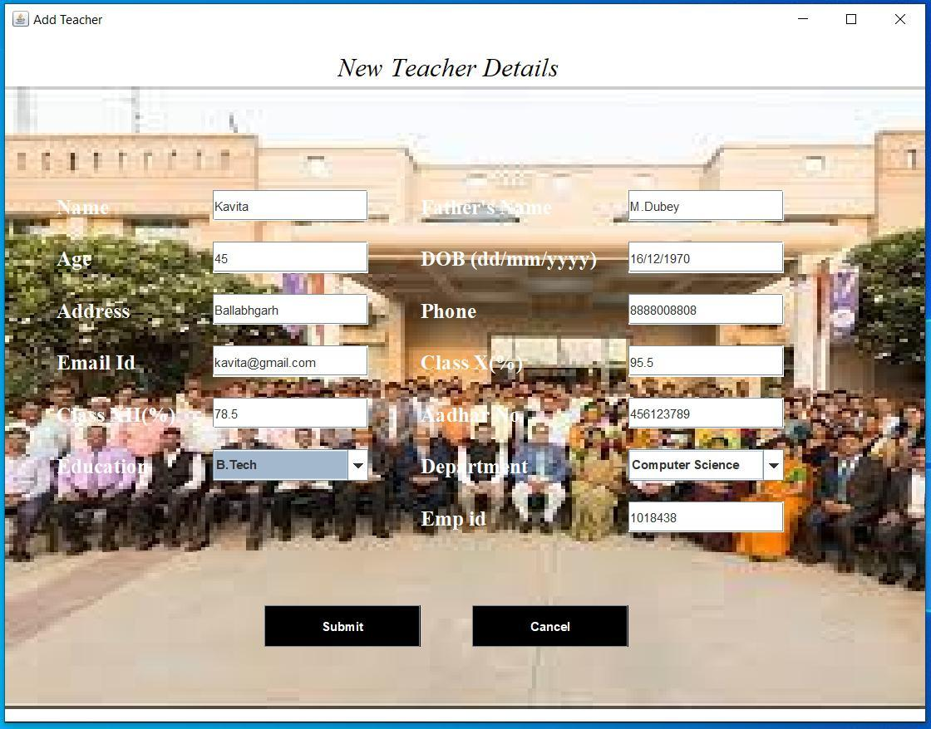
ADD STUDENT ADD TEACHER

Slide 19
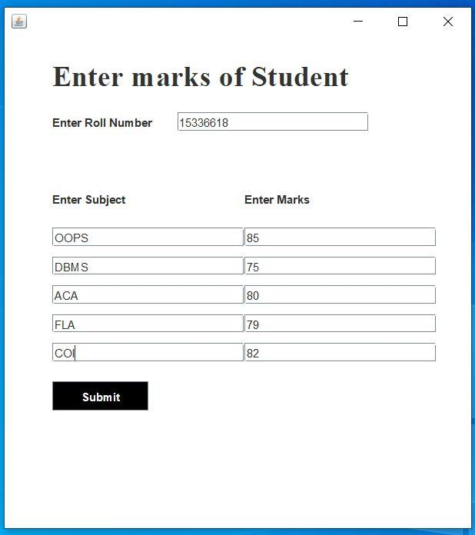
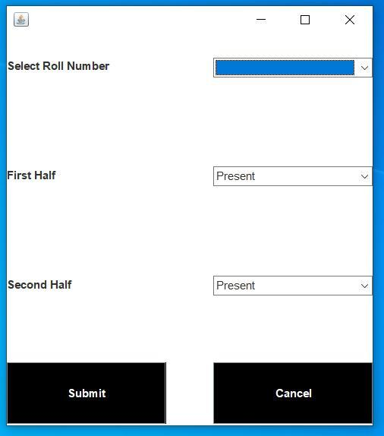
ENTER MARKS ENTER ATTENDENCE

Slide 20
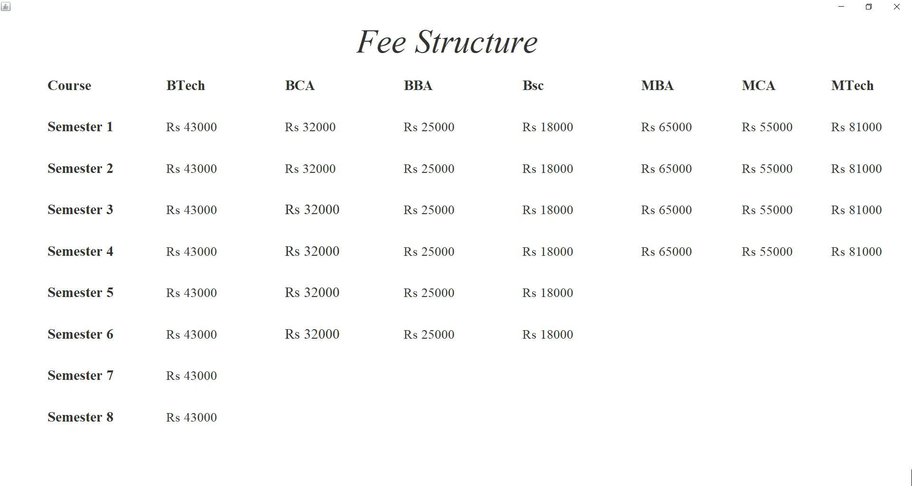
FEE STRUCTURE

Slide 21
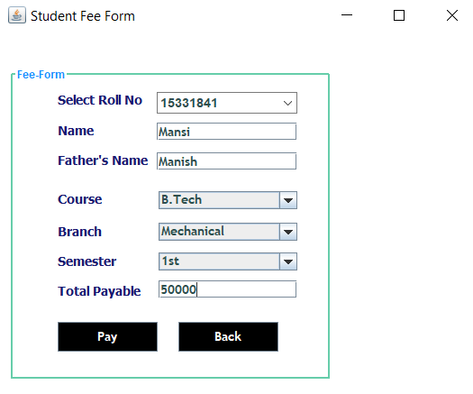
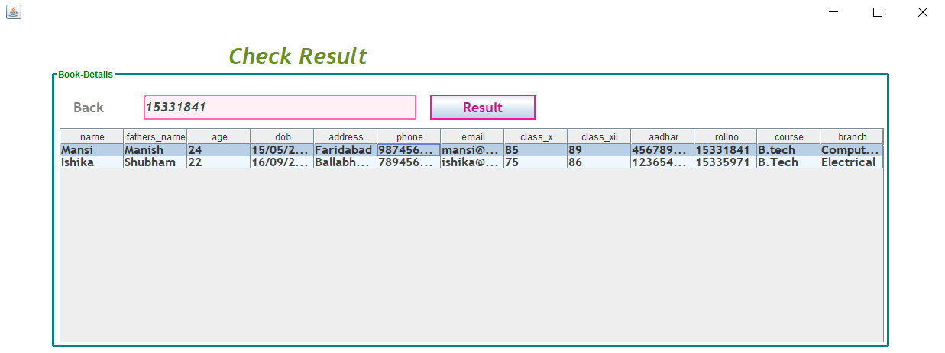
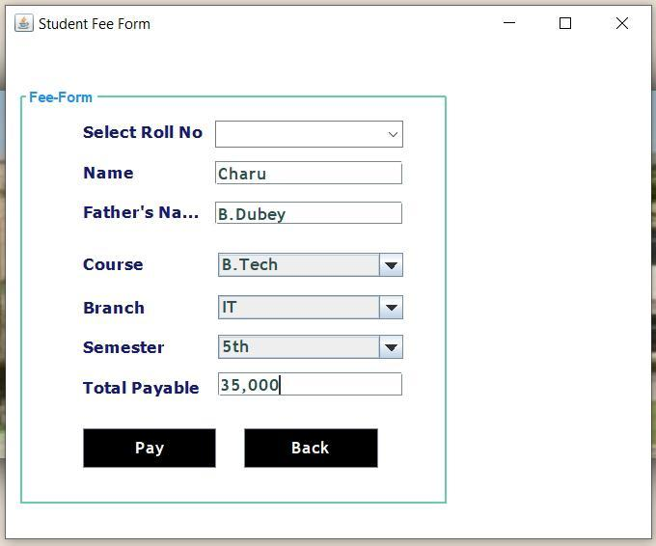
FEE FORM CHECK RESULT

Slide 22
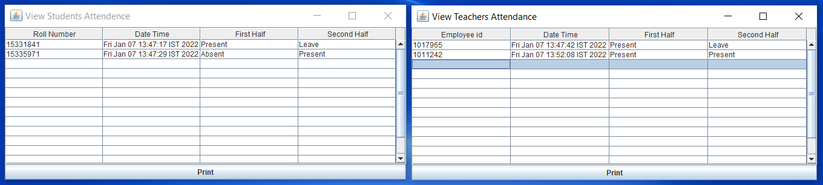
STUDENT ATTENDENCE DETAIL
TEACHER ATTENDENCE DETAIL

Slide 23
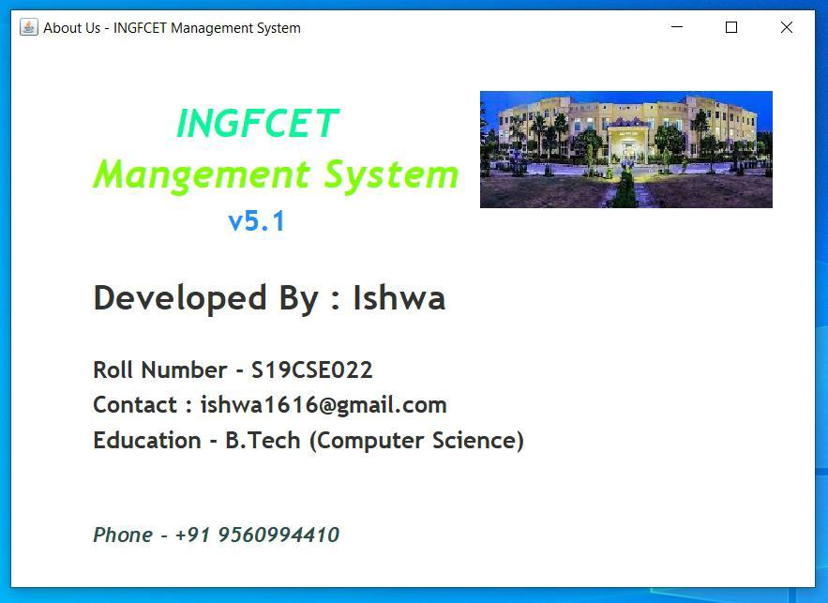
ABOUT

Slide 24
IMPLEMENTATION

Slide 25
Code for about us page
JLabel l1 = new JLabel("New label");
ImageIcon i1 = new ImageIcon(ClassLoader.getSystemResource("university/management/system/icons/first1.jpg"));
Image i2 = i1.getImage().getScaledInstance(250, 100,Image.SCALE_DEFAULT);
ImageIcon i3 = new ImageIcon(i2);
l1 = new JLabel(i3);
l1.setBounds(400, 40, 250, 100);
contentPane.add(l1);
JLabel l3 = new JLabel("INGFCET");
l3.setForeground(new Color(0, 250, 154));
l3.setFont(new Font("Trebuchet MS", Font.BOLD | Font.ITALIC, 34));
l3.setBounds(140, 40, 200, 55);
contentPane.add(l3);
JLabel l4 = new JLabel("Mangement System");
l4.setForeground(new Color(127, 255, 0));
l4.setFont(new Font("Trebuchet MS", Font.BOLD | Font.ITALIC, 34));
package university.management.system;
import java.awt.*;
import javax.swing.*;
public class AboutUs extends JFrame{
private JPanel contentPane;
public static void main(String[] args) {
new AboutUs().setVisible(true); }
public AboutUs() {
super("About Us - INGFCET Management System");
setBackground(new Color(173, 216, 230));
setBounds(500, 250, 700, 500);
contentPane = new JPanel();
setContentPane(contentPane);
contentPane.setLayout(null);

Slide 26
l4.setBounds(70, 90, 405, 40);
contentPane.add(l4);
JLabel l5 = new JLabel("v5.1");
l5.setForeground(new Color(30, 144, 255));
l5.setFont(new Font("Trebuchet MS", Font.BOLD, 25));
l5.setBounds(185, 140, 100, 21);
contentPane.add(l5);
JLabel l6 = new JLabel("Developed By : Ishwa");
l6.setFont(new Font("Trebuchet MS", Font.BOLD, 30));
l6.setBounds(70, 198, 600, 35);
contentPane.add(l6);
JLabel l7 = new JLabel("Roll Number - S19CSE022");
l7.setFont(new Font("Trebuchet MS", Font.BOLD, 20));
l7.setBounds(70, 260, 600, 34);
contentPane.add(l7);
JLabel l8 = new JLabel("Contact : ishwa1616@gmail.com");
l8.setFont(new Font("Trebuchet MS", Font.BOLD, 20));
l8.setBounds(70, 290, 600, 34);
contentPane.add(l8);
JLabel l9 = new JLabel("Education - B.Tech (Computer Science)");
l9.setFont(new Font("Trebuchet MS", Font.BOLD , 20));
l9.setBounds(70, 320, 600, 34);
contentPane.add(l9);
JLabel l10 = new JLabel("Phone - +91 9560994410");
l10.setForeground(new Color(47, 79, 79));
l10.setFont(new Font("Trebuchet MS", Font.BOLD | Font.ITALIC, 18));
l10.setBounds(70, 400, 600, 34);
contentPane.add(l10);
contentPane.setBackground(Color.WHITE);
}
}

Slide 27
CODE FOR CONNECTION
package university.management.system;
import java.sql.*;
public class conn{
Connection c;
Statement s;
public conn(){
try{
Class.forName("com.mysql.jdbc.Driver");
System.out.println("testing1");
c =DriverManager.getConnection("jdbc:mysql://localhost:3306/ums","root","");
System.out.println("testing1");
System.out.println(c);
s =c.createStatement();
}catch(Exception e){
System.out.println(e);
}
}
}

Slide 28
REFERENCE
https://en.m.wikipedia.org/wiki/Java_(programming_language)
https://en.m.wikipedia.org/wiki/SQL

Slide 29
THANK YOU

